Slide 1
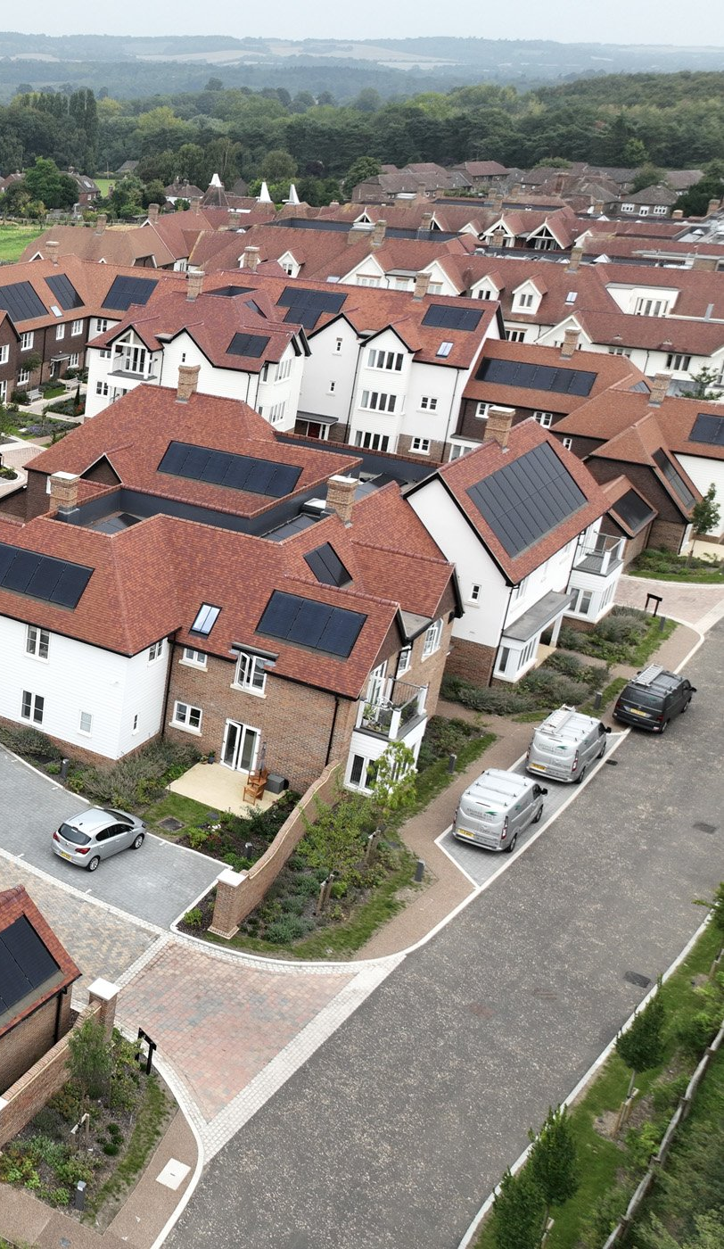

ADVERTISER PACK
2026 / 27
Reach the people
who buy.
For the people who develop, fund and run retirement communities.
SENIORLIFESTYLEBUSINESS.COM
COGENT MULTIMEDIA LTD

Slide 2
WHO YOU REACH
The people you’re getting in front of.
THE LIST TODAY
11,950
named senior living professionals subscribed to the newsletter.
Senior Lifestyle Business goes to operator chief executives, finance and development directors, village general managers, investors and lenders.
25,257
average monthly visits to the Senior Lifestyle Business website.
WHAT THEY BUY
Development, construction and design
63.5%
average open rate against an industry average of 25%.
Resident and assistive technology
Sales, marketing and resident acquisition
Finance, investment and lending
Hospitality, catering and facilities
Legal, planning and advisory services
6.74%
average click rate against an industry average of 2%.
SENIOR LIFESTYLE BUSINESS · WHO YOU REACH
2 / 7
Notes:
Subscribers: Mailchimp, subscribed members on 20 Oct 2026. Open and click rates: pooled across all 7 issues sent to this list. Visits: GA4 sessions, 2026-09-20 to 2026-10-19.

Slide 3
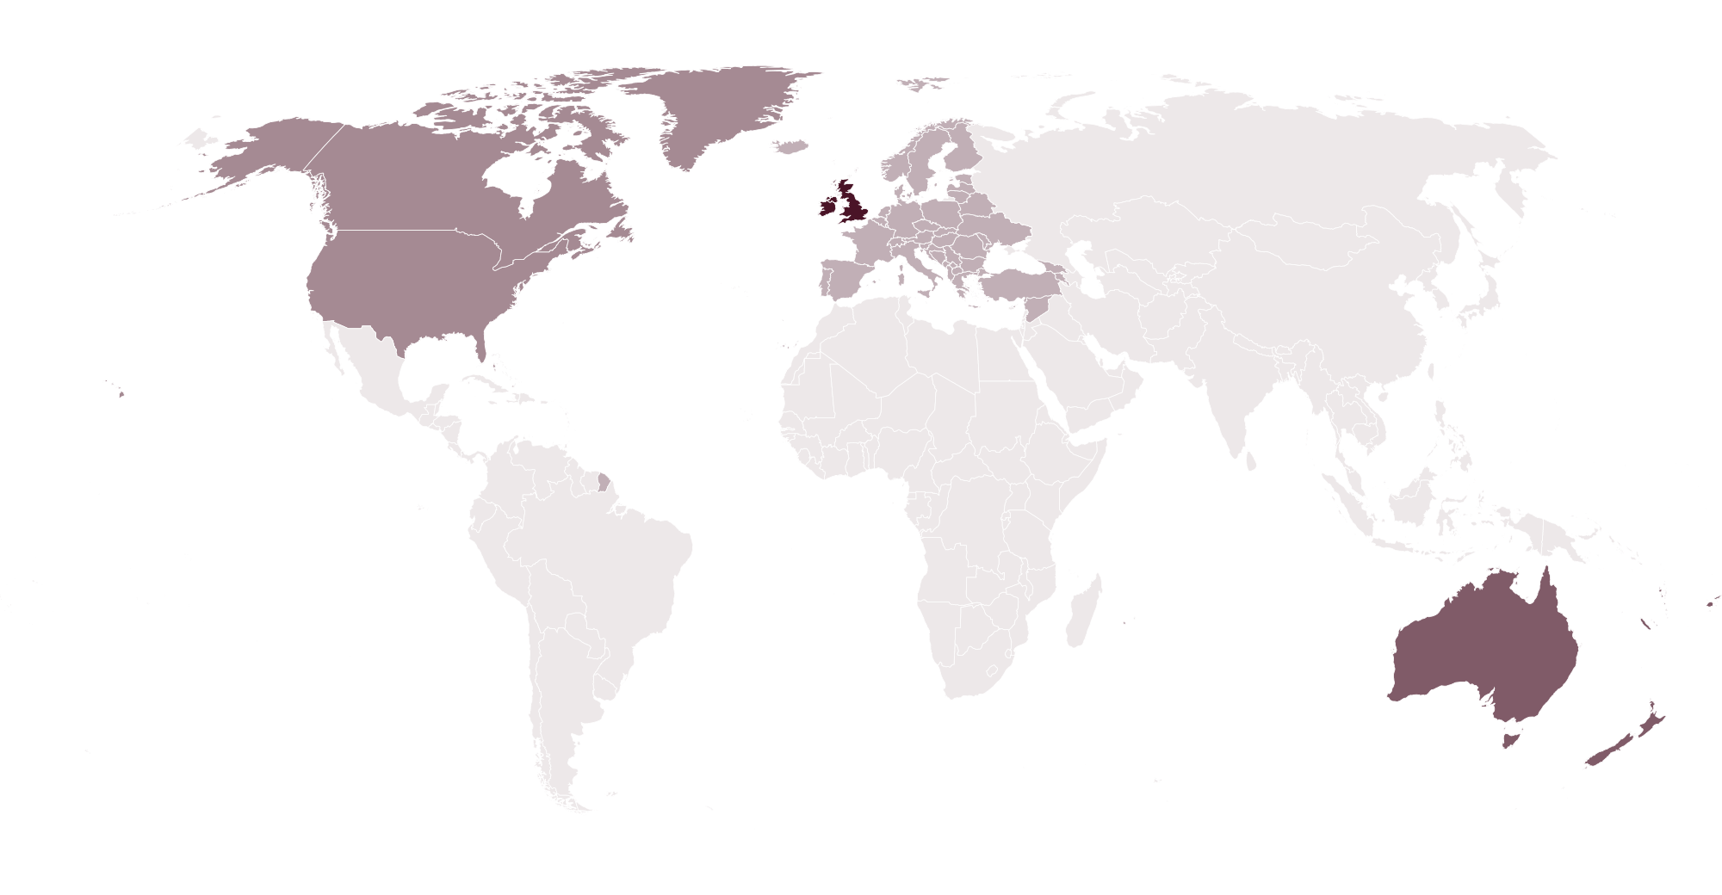
WHO READS · PROJECTED AT SCALE
Who reads Senior Lifestyle Business
86% sit at manager level or above. Projected profile at scale, for planning. Measured figures replace these as the list is profiled.
14%
32%
40%
14%
WHERE THEY ARE
Owner or C-suite
Director
Manager
Specialists
MOST COMMON ROLES
Village general managers
20%
Operations directors
12%
Sales and marketing directors
11%
Development directors
9.0%
Chief executives
8.0%
Investors and lenders
7.0%
48%
24%
18%
6.0%
4.0%
UK and Ireland
Australia and NZ
North America
Europe
Rest of world
ORGANISATION
COMMUNITY SIZE, RESIDENTS
OPERATOR TURNOVER
Operators
52%
Under 100
26%
Under £10m
30%
Developers and builders
18%
100 to 250
40%
£10m to £50m
32%
Investors and lenders
16%
250 to 500
24%
£50m to £250m
24%
Suppliers and advisers
14%
Over 500
10%
Over £250m
14%
SENIOR LIFESTYLE BUSINESS · WHO READS
3 / 7

Slide 4
WHAT YOU CAN BUY
Four ways in.
Every format is digital. Our subscribers have requested to receive content from brands who are able to help their business.
Website banners
Sponsored newsletter content
970×250
300×250
Your brand across the whole site.
Sponsored
Your story in our Monday Briefing, next to our editorial and labelled as sponsored.
HOW A BOOKING RUNS
728×90
01
You tell us what channels you want to use.
970×250 · 728×90 · 300×250
400 words · logo · one link
02
We confirm format, date and price in writing.
03
You send artwork, or copy and we build it.
Newsletter sponsorship
Solus email
04
You approve it before anything goes out.
Sponsor
05
We send the report on your campaign alone.
Your brand as the named sponsor of every issue of our Monday Briefing.
Your email
Your own email, sent to our subscribers. Nobody else in it.
Banner
Per issue, or sponsor a series
We build it, or send finished HTML
SENIOR LIFESTYLE BUSINESS · WHAT YOU CAN BUY
4 / 7

Slide 5
RATES
Build a campaign.
FORMAT
ONE
THREE
SIX
EMAIL
Our team of marketing experts can work with you to build bespoke campaigns to fit your advertising goals and strategies.
All marketing options are built to send our audience straight to your website with one easy click.
Whatever you chose, it’s designed to deliver traffic to you.
Eshot
£1,000
£750
£500
Your message alone, nobody else in it
EACH
EACH
Newsletter sponsorship
£800
£600
£400
Named sponsor of the Monday Briefing
EACH
EACH
CONTENT
Sponsored article
£200
£150
£100
On the website and in the newsletter
EACH
EACH
DISPLAY
ONE MONTH
THREE MONTH
SIX MONTH
Homescreen Pop-Up
£1,200
£2,700
£3,600
Pops up after 6 seconds
TOTAL
TOTAL
Billboard, 970×250
£900
£2,100
£3,000
TALK IT THROUGH
Top of the homepage
TOTAL
TOTAL
jb@seniorlifestylebusiness.com
Leaderboard, 728×90
£600
£1,200
£1,800
Across the site
TOTAL
TOTAL
MPU, 300×250
£400
£800
£1,200
Sidebar button
TOTAL
TOTAL
All rates exclude VAT
SENIOR LIFESTYLE BUSINESS · RATES
5 / 7

Slide 6
WHAT RESULTS YOU GET
The numbers
you get back.
Statistics
All numbers are an average
EMAIL CAMPAIGN
Delivered
Inboxes it actually reached
11,950
Within 7 days of your campaign finishing, you’ll receive a full performance report showing impressions, open rate and click-throughs to your website.
Unique opens
People who opened, counted once
63.5%
Unique clicks
People who clicked, counted once
6.7%
Click to open
Of those who opened, who then clicked
10.6%
Unsubscribes
Off the list after your send
0.04%
ON THE SITE
Monthly Total Visits
Total impressions on your content
25,257
WHEN YOU GET A REPORT
Monthly Unique Visitors
Unique users who saw your content
16,226
Within 7 working days of the send.
SENIOR LIFESTYLE BUSINESS · WHAT RESULTS YOU GET
6 / 7
Notes:
Delivered is the current list size. Rates pooled across 7 issues. Visits and unique visitors: GA4 sessions and total users, 2026-09-20 to 2026-10-19.

Slide 7
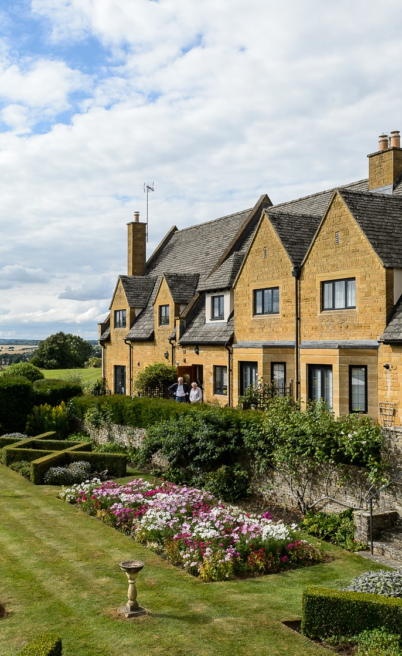
ADVERTISE WITH US
Get in touch.
Tell us who you are trying to reach and what you want it to do, and we will come back with a plan, availability and a price.
ADVERTISING
jb@seniorlifestylebusiness.com
SEND US A STORY
seniorlifestylebusiness.com/submit-news
SUBSCRIBE FREE
seniorlifestylebusiness.com/newsletter
PUBLISHED BY · COGENT MULTIMEDIA LTD, 5 JUBILEE WAY, FAVERSHAM, KENT

